Slide 1

VUPPU REDDY KALYAN
B.E Computer Science & Engineering
(AI&ML)
vuppureddykalyan@gmail.com
https://github.com/Kalyan31104
https://www.linkedin.com/in/vuppureddykalyan/

Slide 2
Enterprise Retail Analytics Platform on Azure
Presented By
Vuppu Reddy Kalyan

Slide 3
Business Scenario
A retail organization receives business data from multiple independent operational systems every day. These systems generate customer information, product details, sales transactions, and exchange rates. Since the data originates from different sources and formats, it cannot be directly used for business reporting or analytics.
The organization requires a centralized, scalable, and automated data platform to integrate, validate, transform, and deliver high-quality analytical data for business intelligence and decision-making. This is the core business scenario described in the project specification.
Datasets | Source
Customers | Azure Sql Database
Products | CSV
Orders | CSV
Exchange Rates | Rest API JSON

Slide 4
Business Challenges
Different file formats (CSV, SQL, JSON).
Duplicate and inconsistent records.
Missing and invalid values.
No centralized storage.
No historical tracking of customer changes.
No Incremental Loading
Business Objective
Develop an automated Azure Data Engineering platform that:
Collects data from multiple sources.
Stores raw data in a centralized Data Lake.
Cleanses and validates incoming data.
Maintains historical customer information.
Supports incremental data loading.
Delivers business-ready data for reporting through Power BI.

Slide 5


Sources
Customers Data
Key Attributes
CustomerID
FirstName
LastName
Email
Phone
City
State
LastUpdated
Orders Data
OrderID
CustomerID
ProductID
OrderDate
Quantity
UnitPrice
StoreCode
Products
ProductID
ProductName
Category
SubCategory
Brand
CostPrice

Slide 6

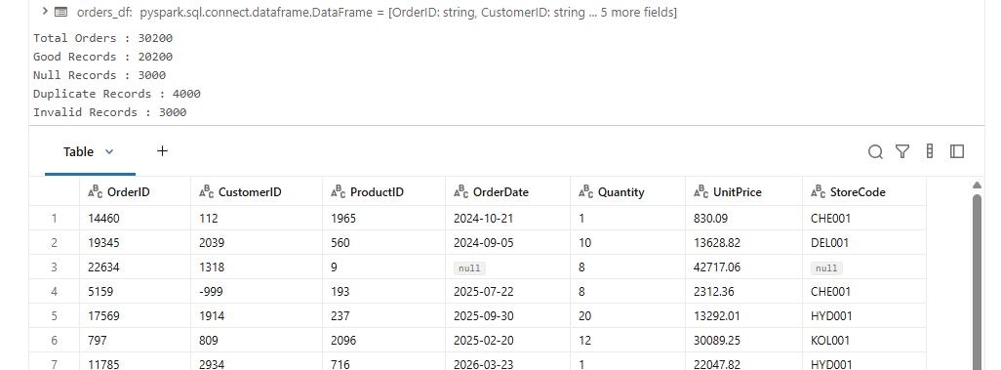
Exchange Rates Data
exchange_info
rate_details
metadata
regions
quality_checks
audit_trail

Slide 7
Solution: Metadata driven Framework
Problem with Traditional Approach
❌ Hardcoded dataset paths
❌ Separate pipeline for each dataset
❌ High maintenance effort
❌ Code changes required for new datasets
Our Solution
✅ Centralized Metadata Configuration
✅ Dynamic Pipeline Execution
✅ Reusable Notebooks
✅ Easy Dataset Onboarding

Slide 8
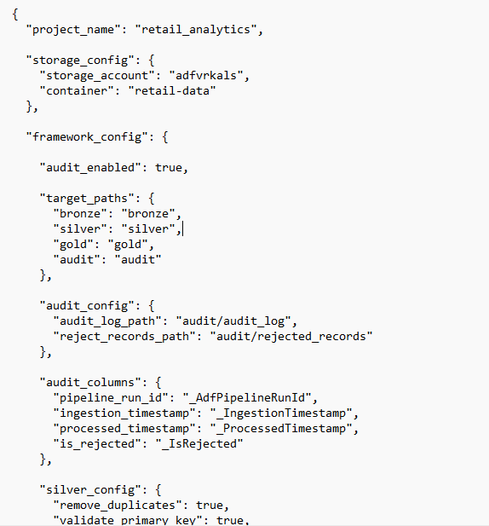
Metadata_Config_Retail.json

Slide 9
Metadata Contains
📂 Project Configuration
Project Name
Storage Account
Container Name
⚙ Framework Configuration
Storage Paths
Bronze Path
Silver Path
Gold Path
Audit Path
Audit Configuration
Audit Log Path
Rejected Records Path
Audit Columns
Pipeline Run ID
Ingestion Timestamp
Processed Timestamp
Rejected Flag
Silver Layer Configuration
Remove Duplicates
Validate Primary Key
Null Invalid Records
Reject Null Mandatory Columns
Capture Rejected Records
Standardize to Null
Apply Business Rules
Default Null Strategy
Validate Foreign Keys
🚀 Publish Configuration
Target Database
Default Schema
Dataset Mapping
Target Table Name
Write Mode
Publish Enable/Disable
📂 Dataset Configuration
Dataset Name
Active Status
Source Type
Source Path
File Format
Table Name

Slide 10
Processing Configuration
Load Type
Watermark Column
Partition Columns
Flatten Required
🔑 Key Configuration
Primary Key
Relationships (Foreign Keys)
✅ Validation Configuration
Mandatory Columns
Numeric Columns
Date Columns
Timestamp Columns
Email Columns
Positive Value Columns
💼 Business Rule Configuration
Regex Validation
Minimum Value Validation
Dataset Specific Business Rules
📋 Schema Configuration
Column Name
Data Type
Nullable Constraint
🏗 Target Configuration
Bronze Table
Silver Table
Gold Table
📊 Gold Layer Configuration
Table Type (Fact/Dimension)
Fact Name
Surrogate Key
🔄 SCD Configuration
SCD Enable/Disable
SCD Type
Tracked Columns

Slide 11
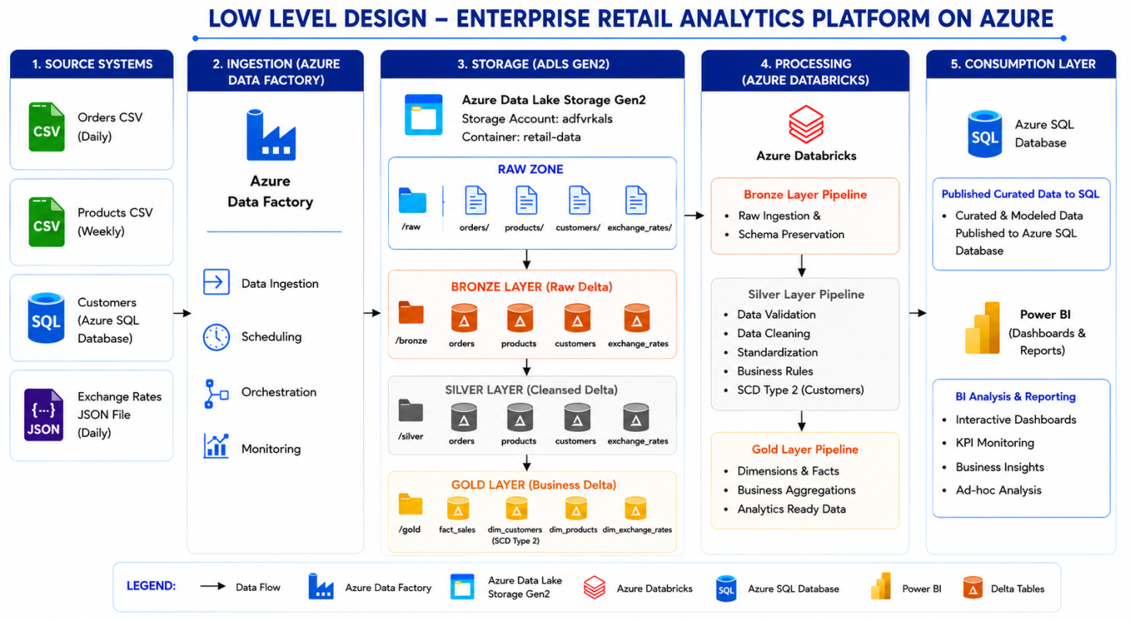
Architecture

Slide 12
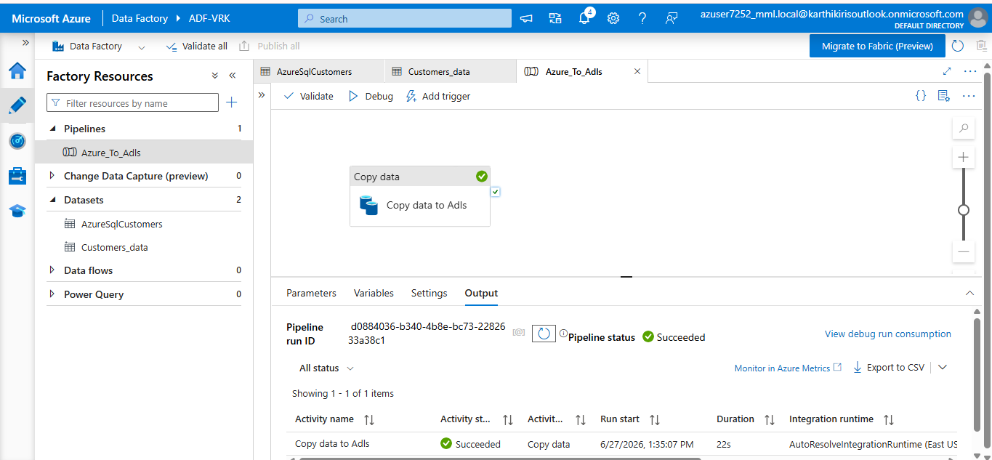
Azure Sql to Adls

Slide 13
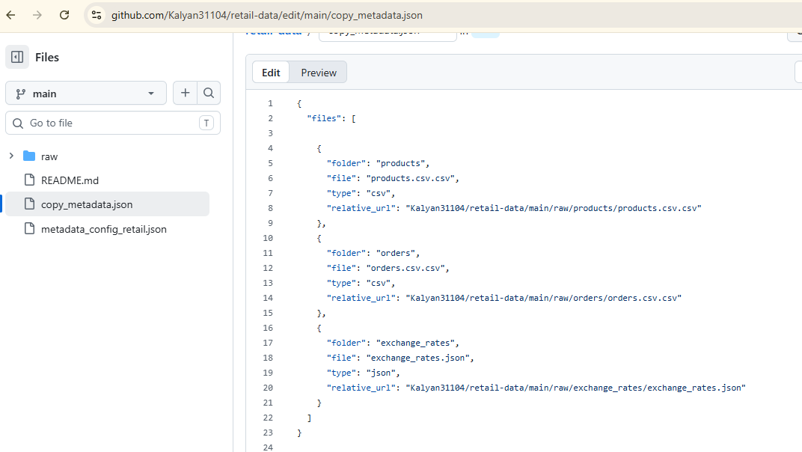
Copy_Metadata.json

Slide 14
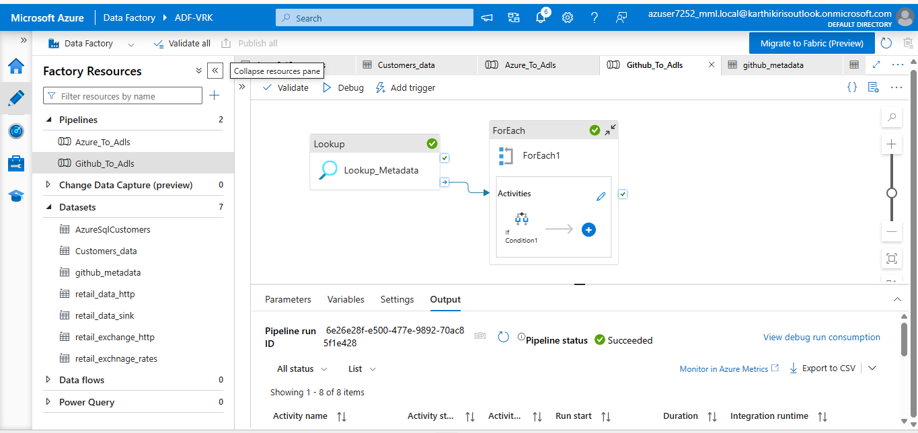
Pipeline : Github to Adls
Lookup Activity
Reads the configuration file that is uploaded in the github which has details like path ,datasetname , and type of data.
Retrieves theinformation as a list.
For Each Activity
Iterates through each dataset returned by the Lookup activity.
Executes the ingestion logic for one dataset at a time.
If Condition
Checks the source type defined in the file.
Routes the execution to the appropriate Copy Data activity.

Slide 15
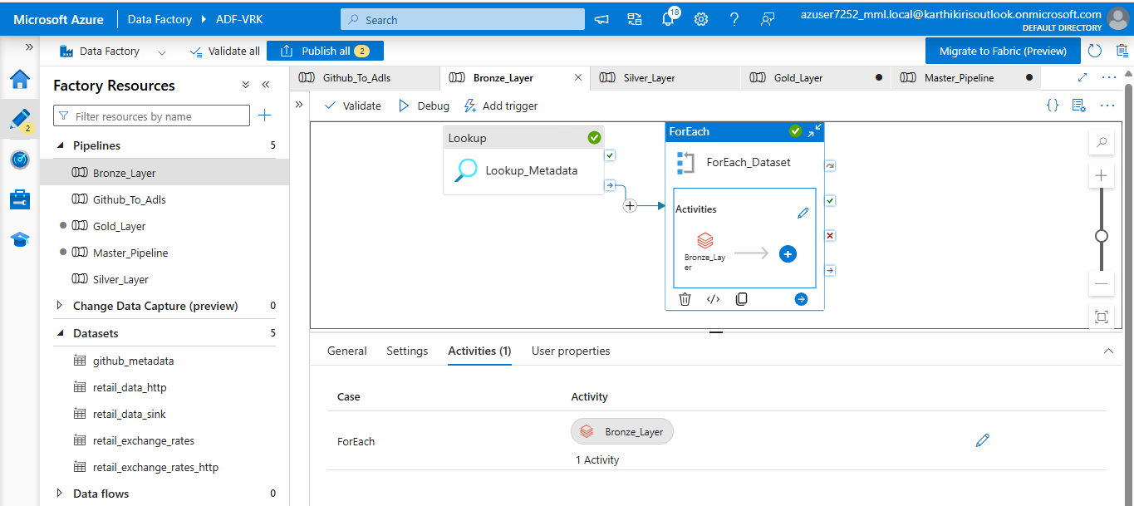
Pipeline : Bronze Layer
Read dataset configuration from metadata.
Execute Bronze notebook for each dataset.
Convert raw data into Delta format.
Preserve original source data with audit information.

Slide 16
📂 read_source_file()
Reads raw files from ADLS Gen2.
📅 get_watermark()
Retrieves the last successfully processed watermark value.
Used to identify new or modified records.
🔄 Incremental Filter
Here we compare the raw data with the previous watermark value and the data whose watermark column’s data is updated i.e increased then only we are going to append the data.
📝 add_audit_columns()
Adds technical columns such as:
_AdfPipelineRunId
_IngestionTimestamp
💾 write_delta()
Stores the incremental records in the Bronze Delta tables.
🔄 update_watermark()
After a successful load:
Finds the latest watermark value from the processed records.
Stores it for the next execution.

Slide 17
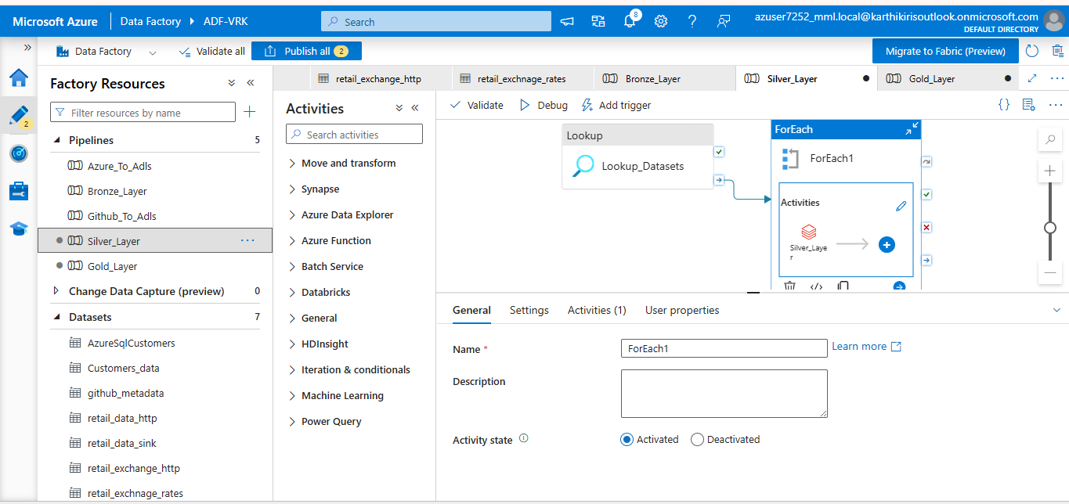
Pipeline : Silver Layer

Slide 18
⚙️ Processing Steps
📂 read_delta()
Reads Bronze Delta tables from ADLS.
Loads data into Spark DataFrame.
🔄 flatten_df()
Flattens nested JSON structures.
Executed only when flatten_required = true.
🔑 validate_primary_key()
Checks for NULL Primary Keys.
Ensures uniqueness of records.
🔄 remove_duplicates()
Removes duplicate records.
Uses Primary Key defined in metadata.
📋 apply_schema()
Reads schema from metadata.
Converts columns to appropriate data types.
Standardizes column structure.

Slide 19
📅 standardize_null_values
Converts Invalid String data to nulls
📧 validate_email_columns()
Validates email format using Regex.
Convert invalid email addresses into null.
➕ validate_positive_values()
Ensures business fields contain positive values.
Example: Quantity, UnitPrice, ExchangeRate.
💼 apply_business_rules()
Executes dataset-specific business validations.
Convert records violating business conditions to null.
✅ validate_mandatory_columns()
Verifies mandatory fields.
Rejects records with missing required values.
🔑 validate_foreign_key()
Checks for relationship between tables

Slide 20
✔ validate_schema_evolution()
Verifies that the incoming dataset matches the expected schema.
Checks column names and data types.
Rejects records or flags schema mismatches.
🚫 capture_rejected_records()
Stores invalid records separately.
Records rejection reason for analysis.
📝 add_audit_columns()
Adds technical columns such as:
_IsRejected
_ProcessedTimestamp
💾 write_delta()
Writes only validated records.
Stores data in Silver Delta tables.
📝 write_audit_log()
Stores execution details.
Captures source count, target count, rejected count, and status.

Slide 21
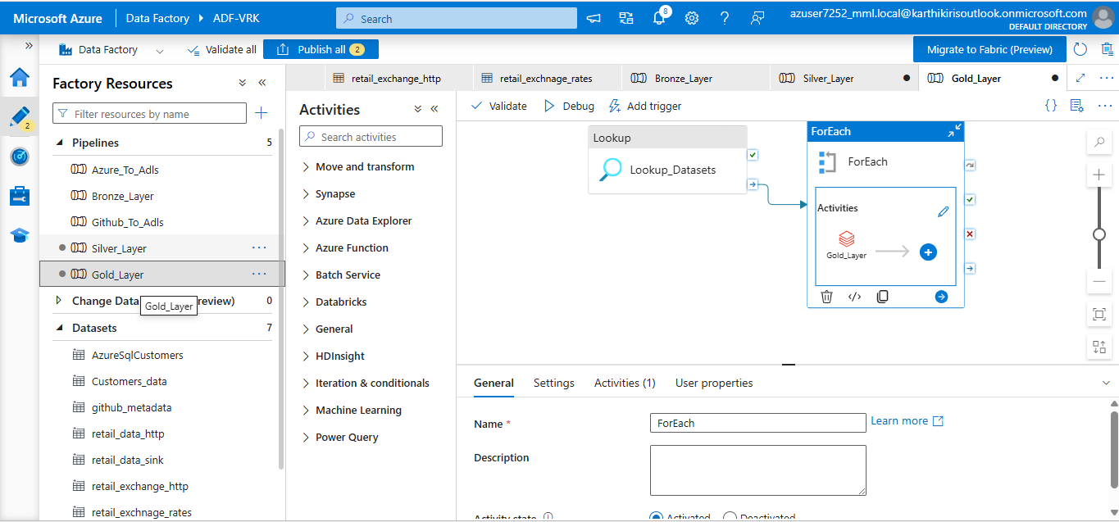
Pipeline : Gold Layer

Slide 22
⚙️ Processing Steps
📂 read_delta()
Reads validated Silver Delta tables.
Loads data into Spark DataFrame.
📑 get_dataset_config()
Reads Gold configuration from metadata.
Identifies
Table Type
Target Table
SCD Configuration
Surrogate Key
Publish Settings
🏗 process_dimension()
Identifies Dimension datasets.
Creates Gold Dimension tables.
Generates Surrogate Keys.
Executes SCD processing if enabled.
Example
Customers->Dimension Table
🔄 process_scd()
Reads SCD configuration.
Detects changes in tracked columns.
Maintains historical records.
Updates Current Flag and Effective Dates.
Only executed for Customers

Slide 23
💾 write_delta()
Stores curated tables in Gold.
📝 write_audit_log()
Stores execution details.
Tracks successful Gold processing.
📊 process_fact()
Identifies Fact datasets.
Creates analytical Fact tables.

Slide 24
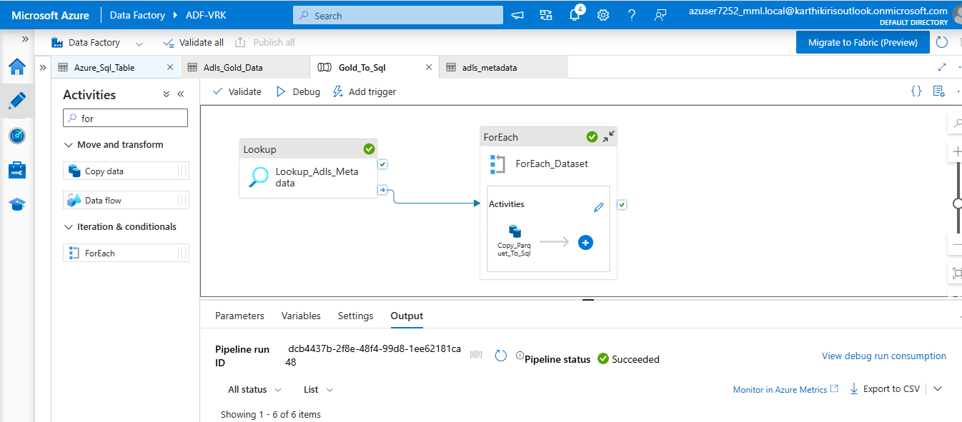
Gold to Sql

Slide 25
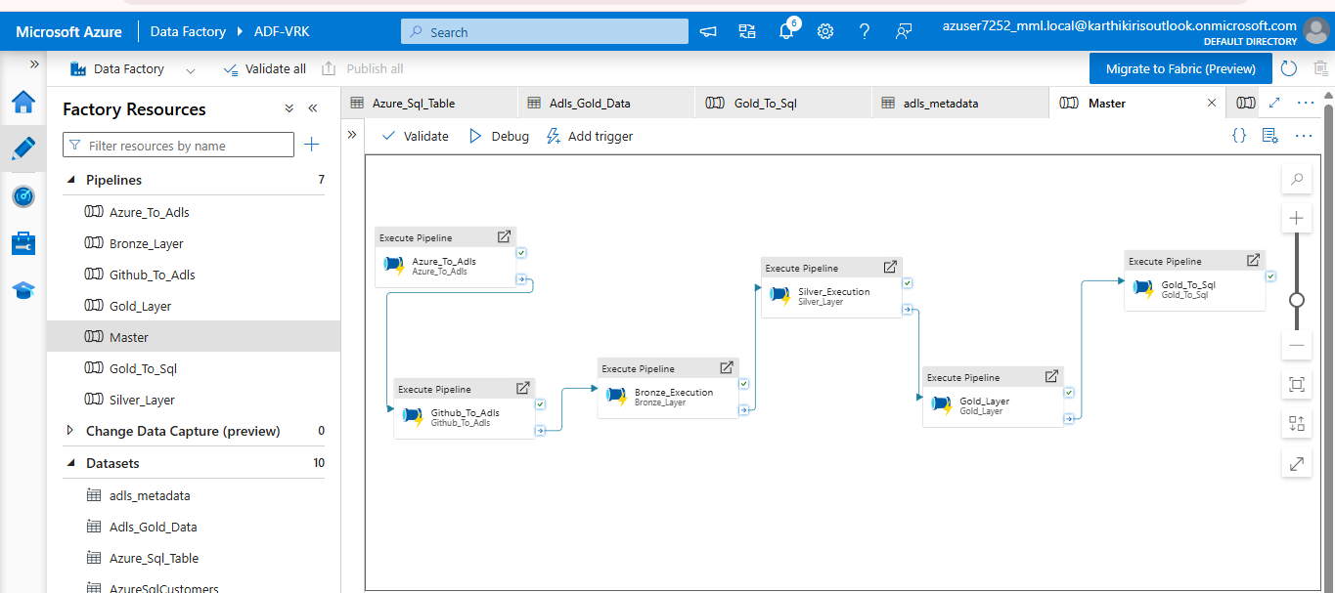
Master Pipeline

Slide 26
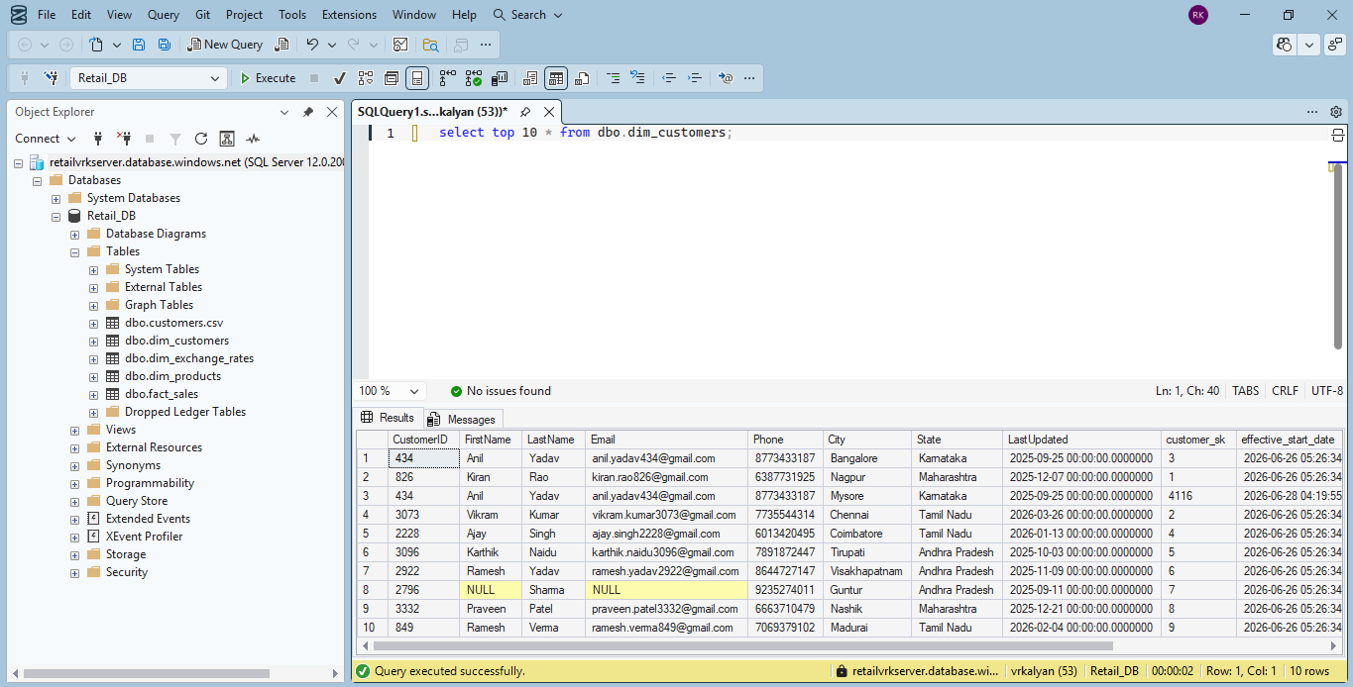
Azure Sql Server

Slide 27
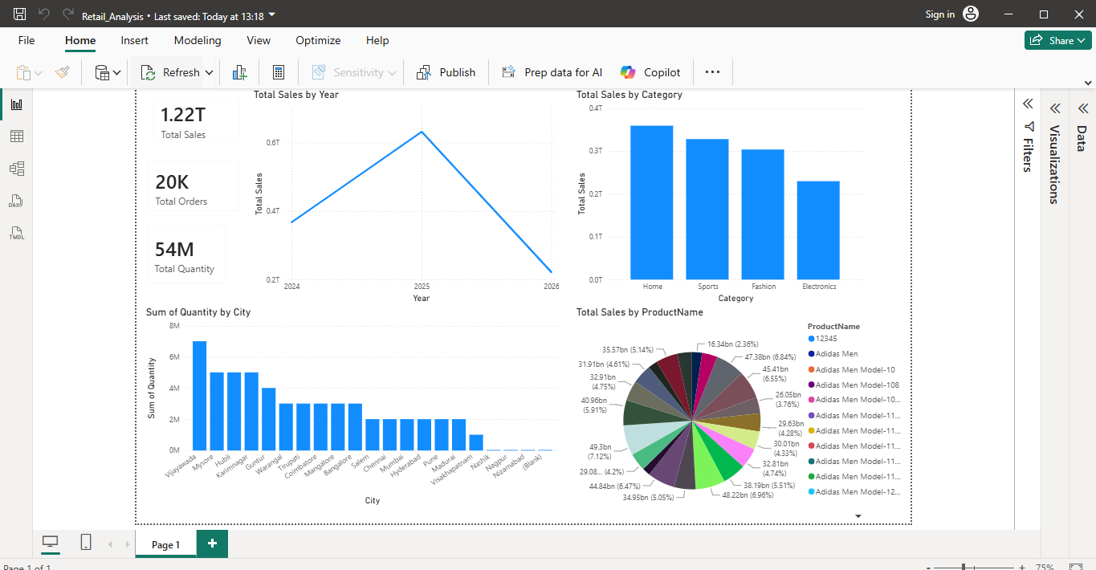
Retail Analysis

Slide 28
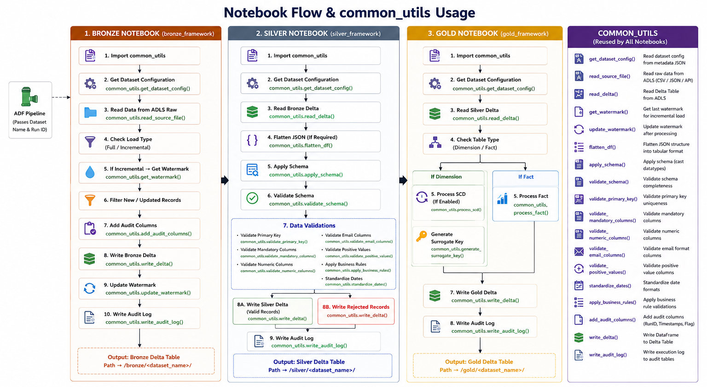
Executing Flow

